Slide 1
Road Safety

Slide 2
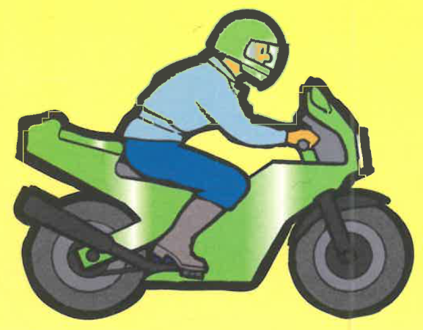
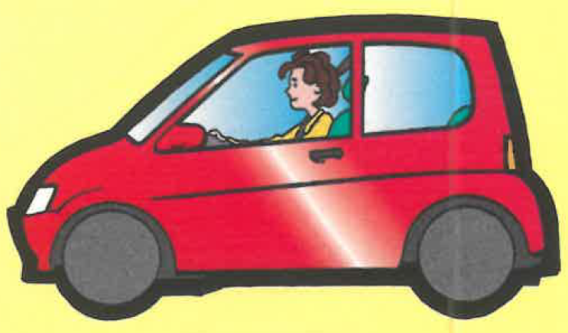
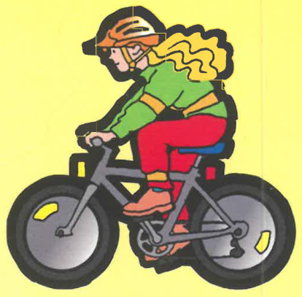
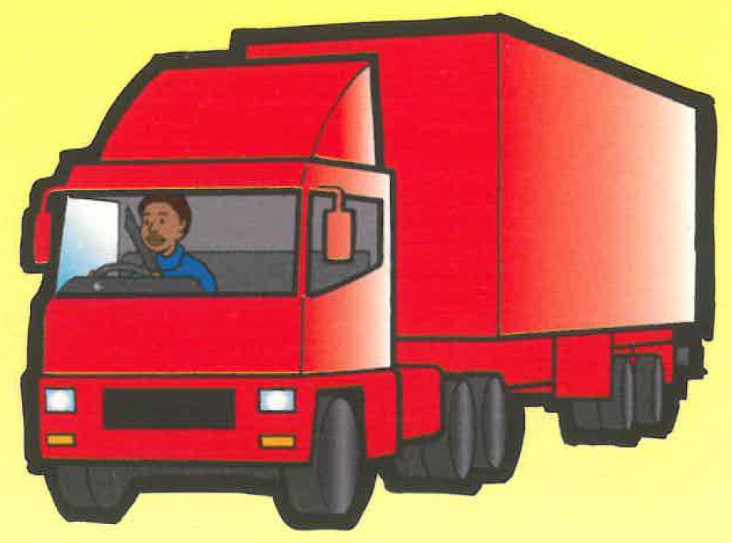
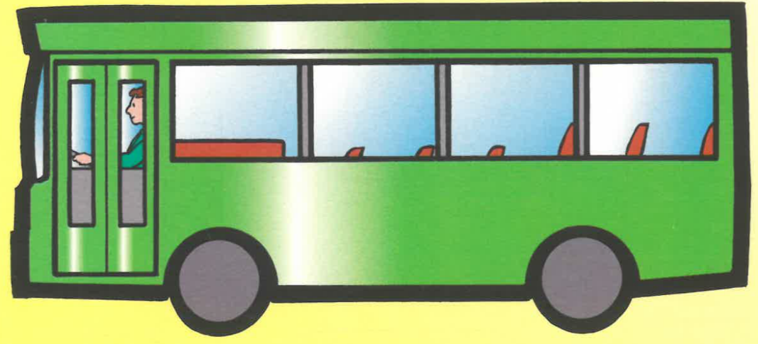
What goes on the road?
Notes:
What goes on the road?
Car – what should you put on when you are sat in the car or in your special seat? - Seatbelt
2 different bikes – which one can you hear?
You need to use both eyes & ears when near the road – some things you can’t hear on the road – electric cars?
Large vehicles – blind spot

Slide 3
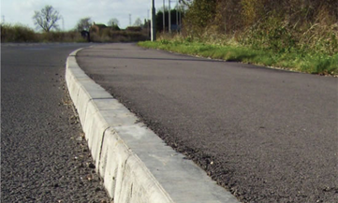
Road Safety Basics
What do we walk on?
Pavement
Kerb
On the inside, well away from the traffic
Notes:
What do we walk on – the pavement
What’s the edge of the pavement called? – the kerb
Do we walk on the kerb? Where should we walk? – on the inside

Slide 4
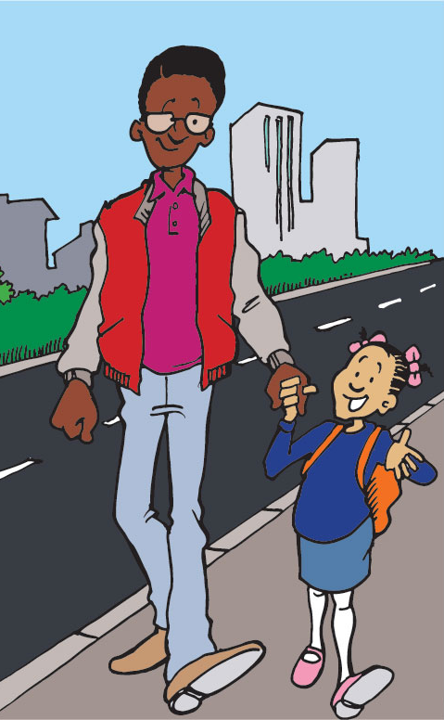
Keeping safe
Hold hands or stay close to your grown up, walking on the inside away from the traffic
Notes:
Walk on the inside of the pavement.
Have the grown up on the road side.

Slide 5
Before we cross the road
When crossing the road what should you do when you get to the kerb?
STOP

Slide 6
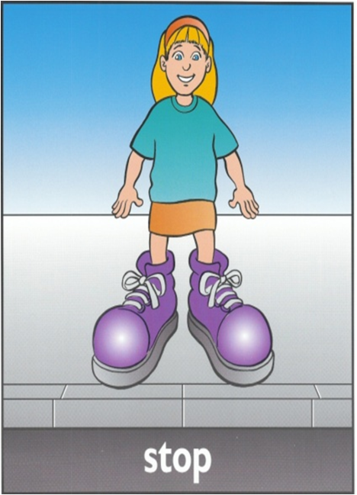
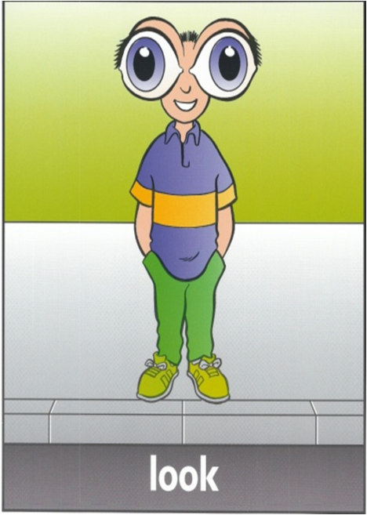
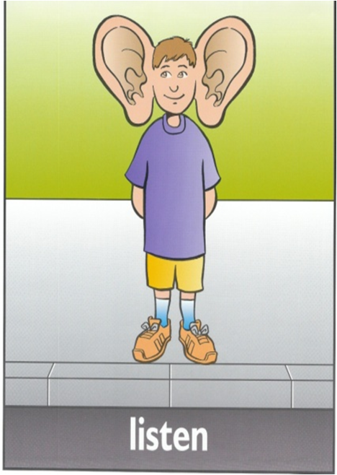
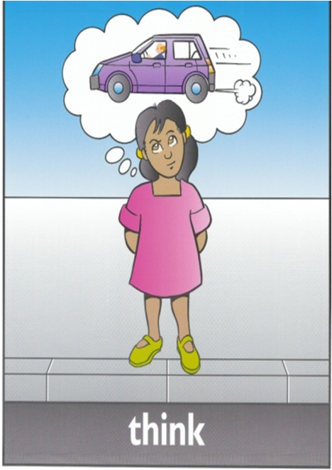
Green Cross Code
Stop at the Kerb
Stand back from the edge
Look Right, Left, Right until clear
Listen for all vehicles NOT just cars
Think - is it safe to cross

Slide 7
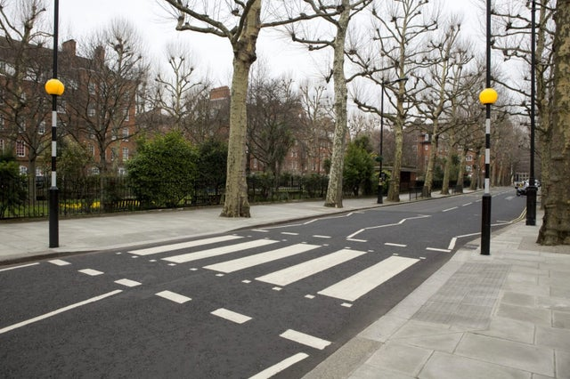
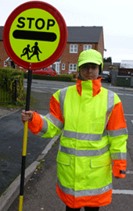
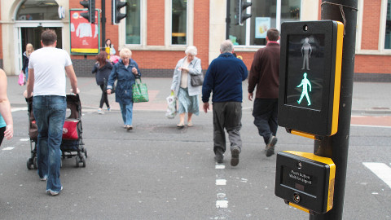
On your way to school
Notes:
On your way to school – do you see any of these? These are all safer places to cross the road
Lollipop person – look at the hi-viz, bright uniform
Zebra crossing
Puffin crossing

Slide 8
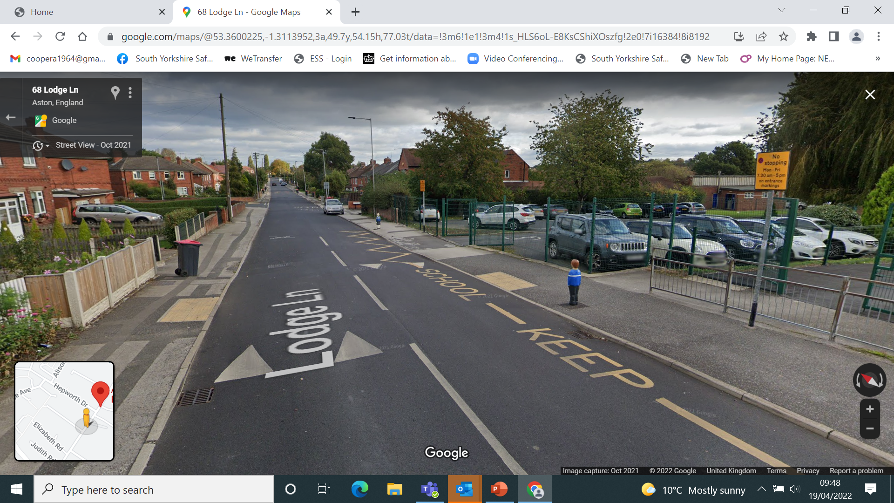
Notes:
Add a google street view photo to emphasise local messages – driveways, parking on zig zags, parked cars, junctions, crossings etc

Slide 9
Hazard spotting image 2
Notes:
Spot the good behaviour (1), and any hazards (3)
Hazard
Dog and children running into the road
On a skateboard near the road and no helmet
Playing catch next to a road, with back to road
Good behaviour
Holding hands with an adult, with the adult road-side

Slide 10
Keep yourself safe
Always remember :
Use The Green Cross Code when crossing the road
Use the special crossings that help us to cross safely
Don’t mess around or play near roads
Hold hands or stay close to your adult
Look after yourself, your friends & family and keep safe

