Slide 1

Road Safety Essentials for KS2

Slide 2
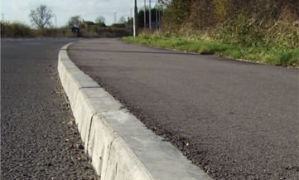
Road Safety Essentials
What do we walk on?
Pavement
Kerb
On the inside, well away from the traffic

Slide 3
When crossing the road what should you do when you get to the kerb?
STOP

Slide 4
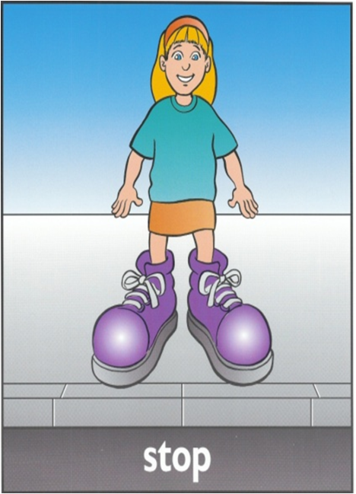
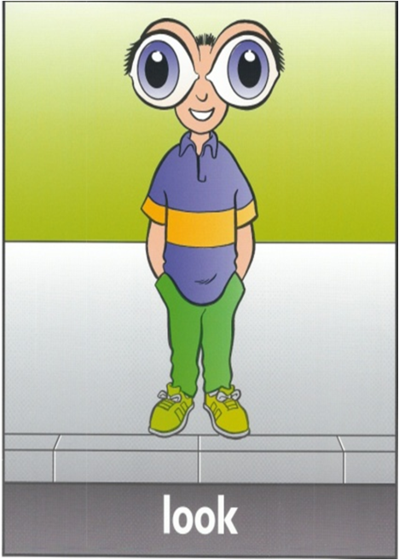
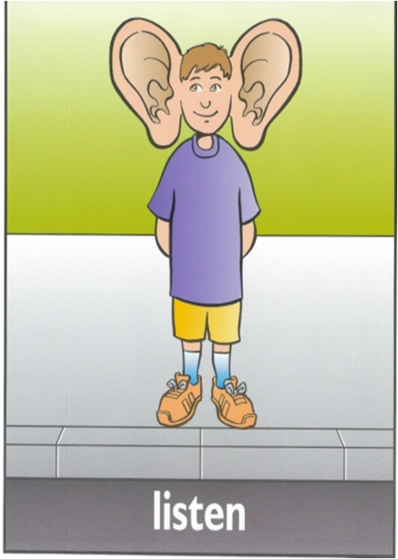
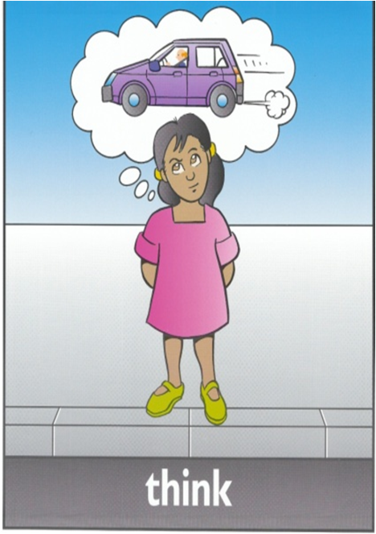
Do you remember the Green Cross Code
Stop at the Kerb
Stand back from the edge
Look Right, Left, Right until clear
Listen for all vehicles NOT just cars
Think - is it safe to cross

Slide 5
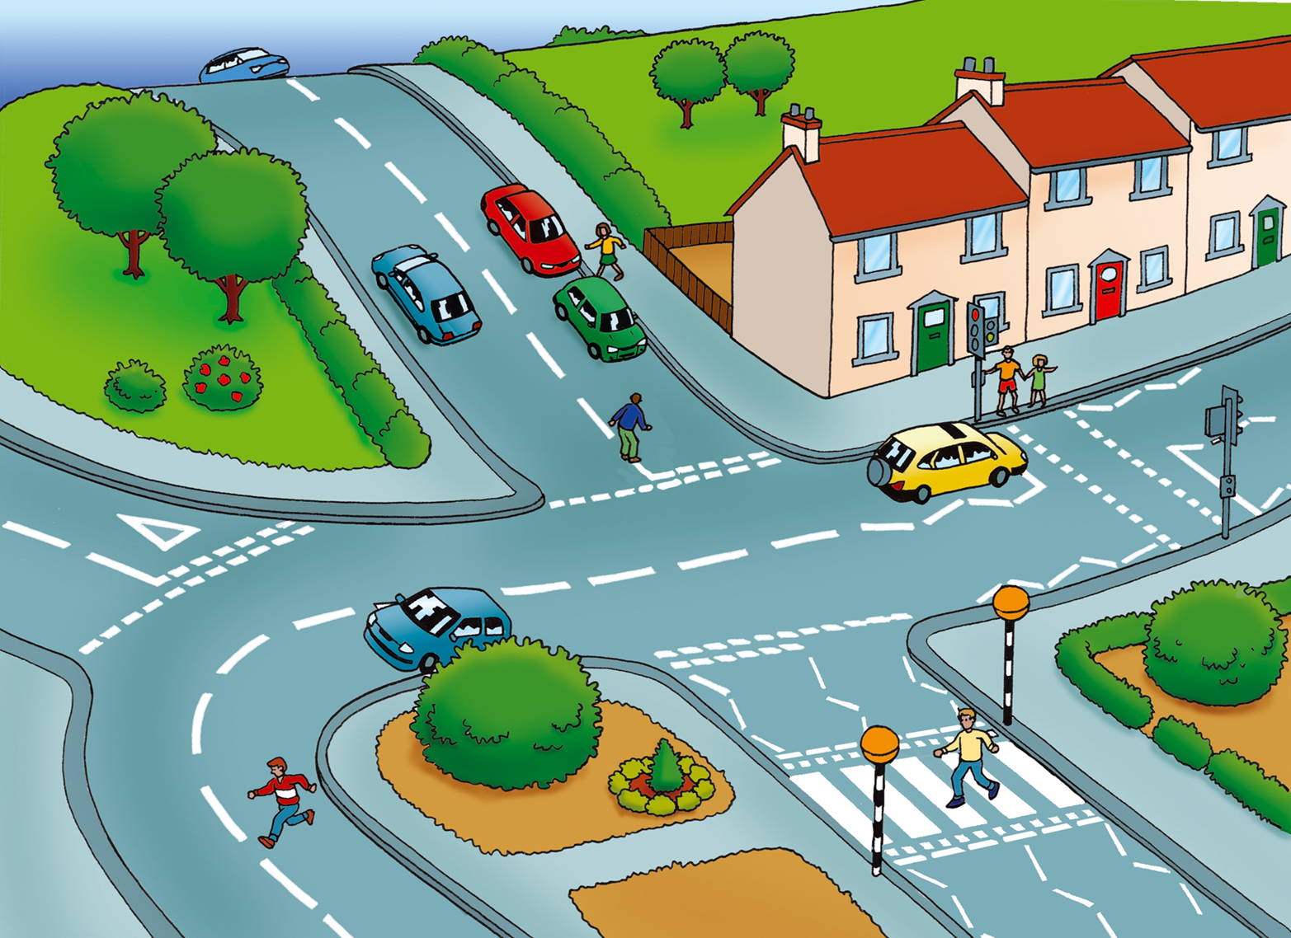
Do you remember the Green Cross Code?
Notes:
Who is being safe and who is not safe on this picture
Man crossing on zebra
People using pedestrian crossing and holding hands
Boy running across the road and is it safe to cross on a bend – could he see the blue car. Why shouldn’t we run?
Man stood in the middle of the road?? Close to a junction.
Girl crossing between parked cars – can be dangerous – you can’t see and other cars can’t see you.

Slide 6
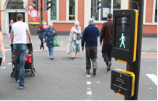
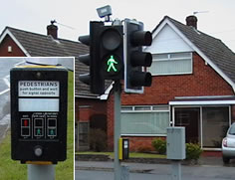
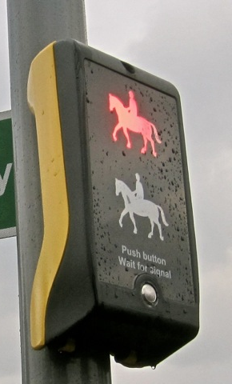
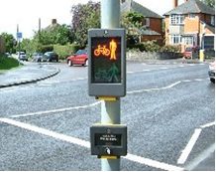
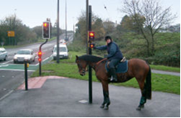
Safer places to cross
Pelican Crossing
Puffin Crossing
Pegasus crossing
Toucan Crossing
Notes:
These crossings all use the traffic lights to stop traffic.
Even though the green man is lit – check up & down the road to make sure the cars have stopped or are slowing down.

Slide 7
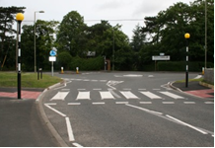
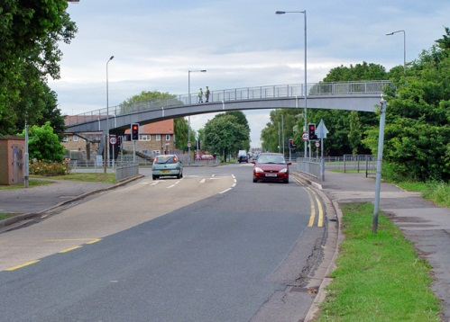
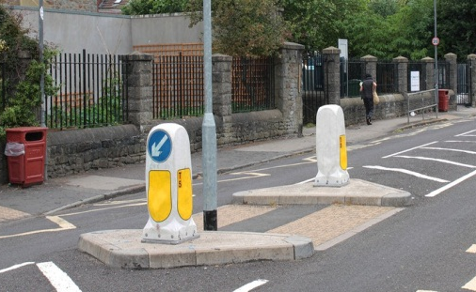
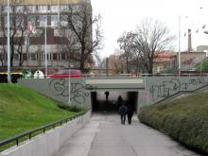
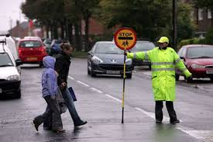
More safer places to cross a road
Footbridge
Zebra Crossing
Island
School Crossing Patrol
Subway

Slide 8
Keep yourself safe
Road safety is easy and common sense…it’s just that sometimes, we forget or we are persuaded to do things that are not safe.
Always remember :
Use The Green Cross Code when crossing the road
Be careful when crossing driveways or entrances
Use the special crossings that help us to cross safely
Don’t mess around or play near roads
Look after yourself and keep safe

